Slide 1
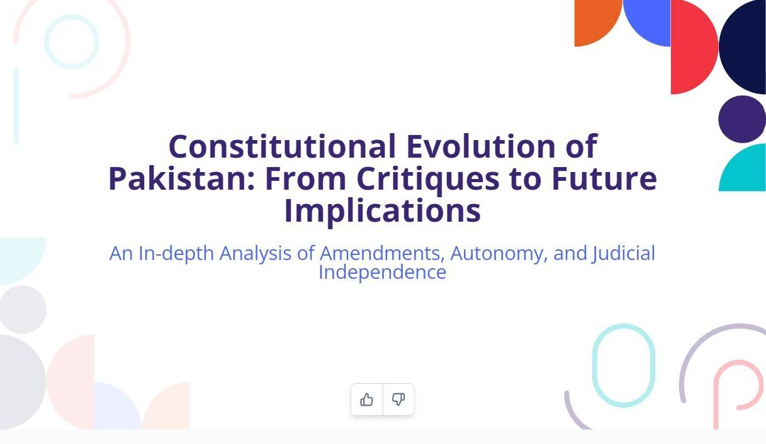
CamScanner

Slide 2
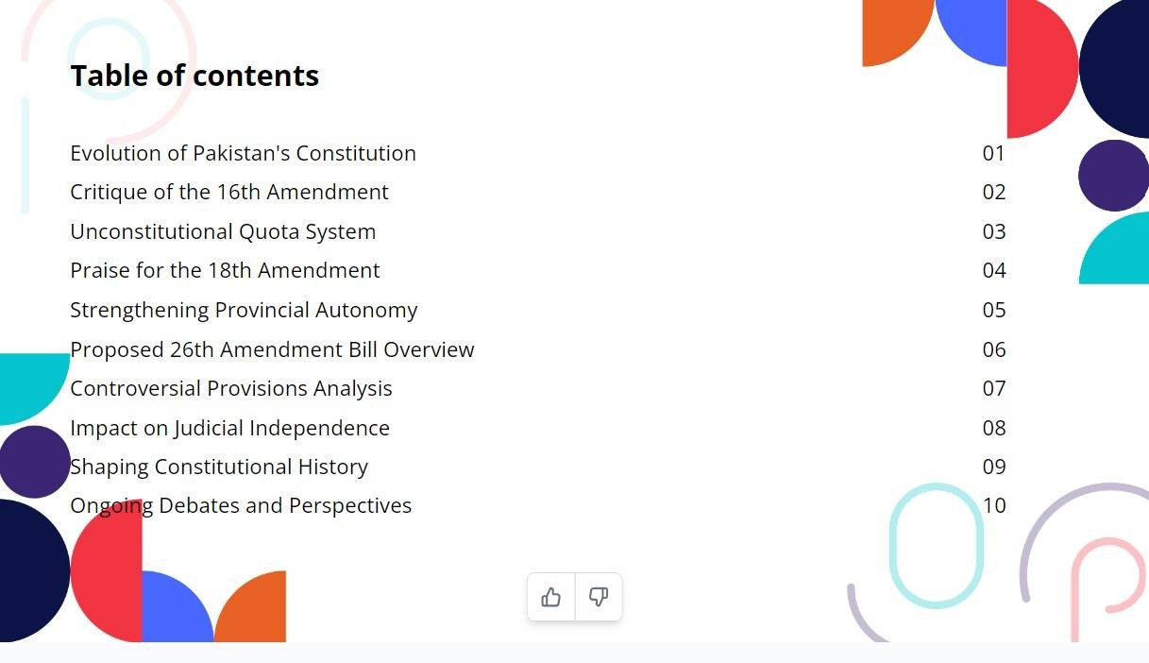
CamScanner

Slide 3
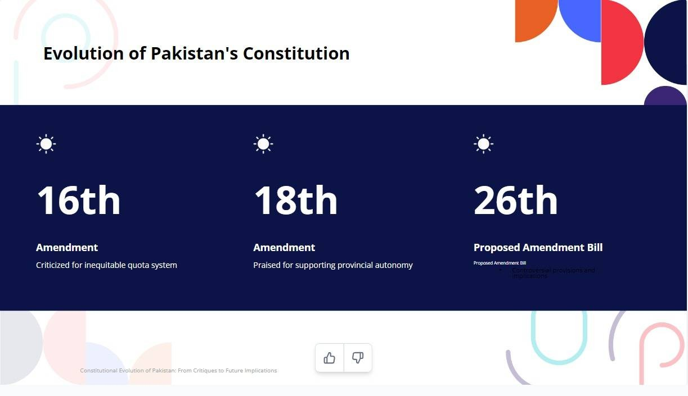
CamScanner

Slide 4
18th Amendment
• Enhanced provincial autonomy, reduced federal control.
• Strengthened democratic institutions and improved accountability.
• Key objective: Address historical neglect of provinces.
• Impact: Promoted democracy and equity among provinces.

Slide 5
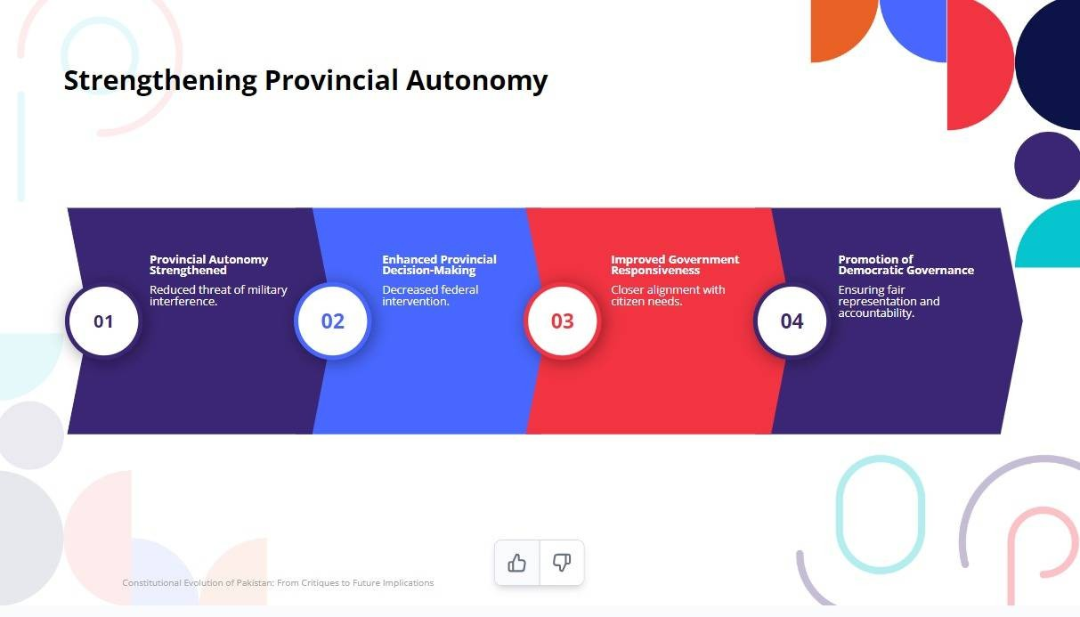
CamScanner

Slide 6
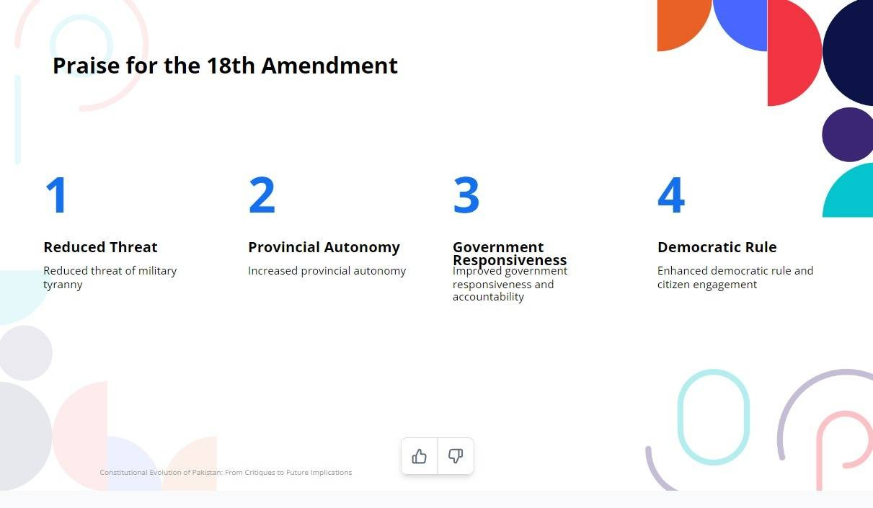
CamScanner

Slide 7
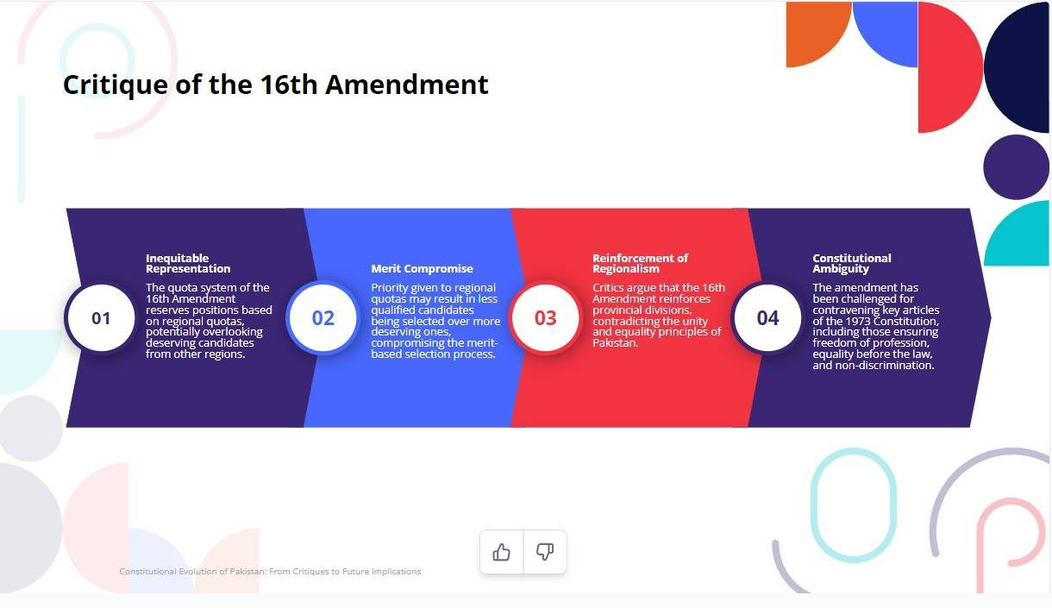
CamScanner

Slide 8
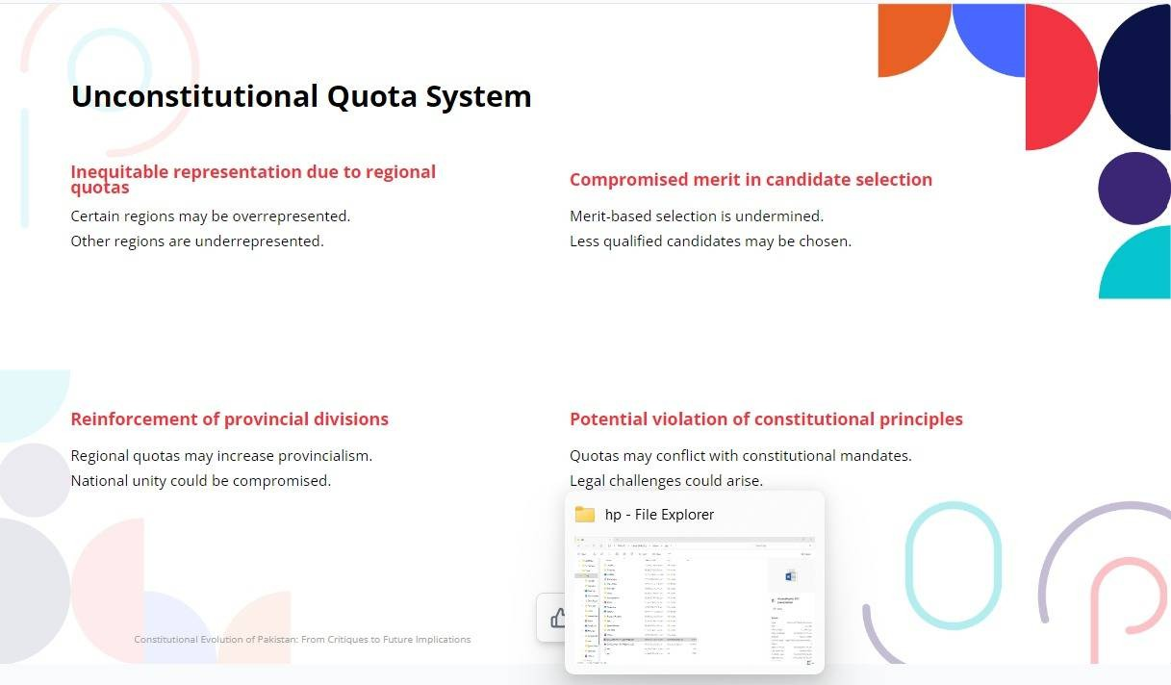
CamScanner

Slide 9
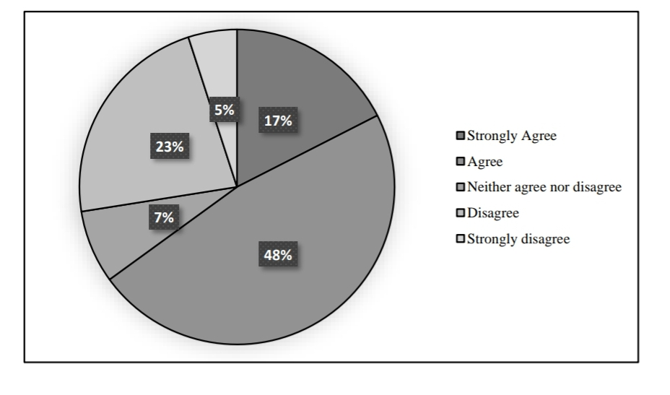
Satisfaction With Provision of Quota System in Pakistan

Slide 10
16th Amendment
• Issues:
- Potential compromise on merit and regional fairness.
• Introduced quotas for government jobs to improve representation.
- Violates equality and non-discrimination principles.
• Outcome: Ruled unconstitutional by the Supreme Court.

Slide 11
23rd Amendment Bill
• Procedure to appoint the Chief Justice of Pakistan has been changed.
• Amendments in Article 175A: A 12-member committee will decide the new Chief Justice.
• New Article 191A: Constitutional benches will be formed.
- Members of these benches will be decided by the Judicial Commission.
- Judicial Commission members include parliamentarians, leading to indirect influence on the judiciary.
- This could result in partial decisions, undermining the independence of the judiciary.
• Supreme Court's powers have been restricted.
- Supreme Court can no longer transfer cases to other high courts.
- The right to issue declarations has been removed, further compromising judicial independence.

Slide 12
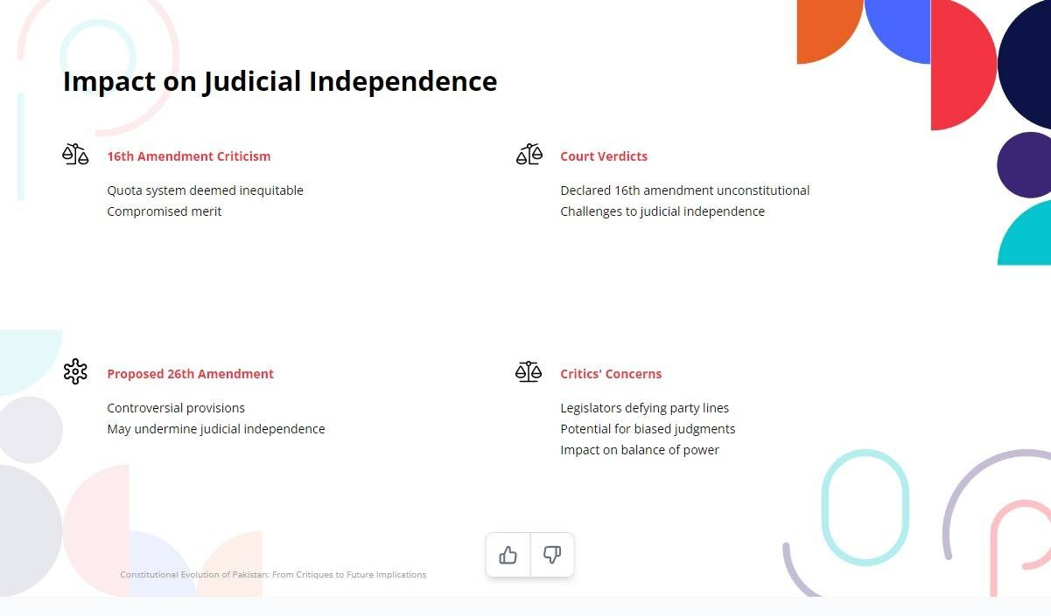
CamScanner

Slide 13
Conclusion
• Amendments like the 16th and 18th were necessary to fix gaps.
• The 23rd Amendment risks centralizing power and weakening judiciary.
• Need for reforms to maintain democratic principles and governance balance.

Slide 14
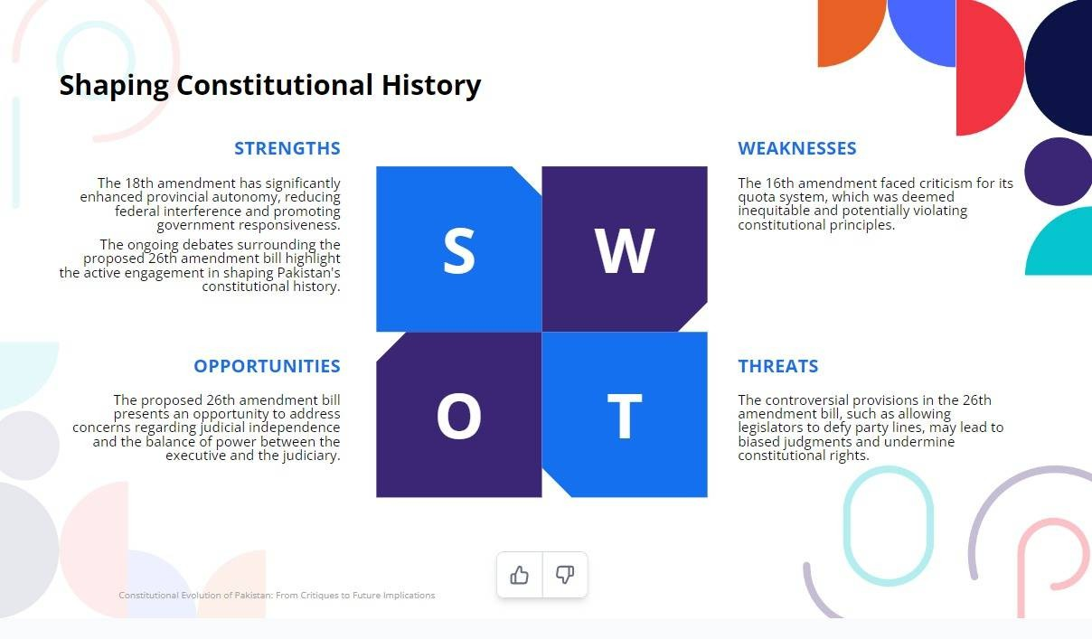
CamScanner

Slide 15
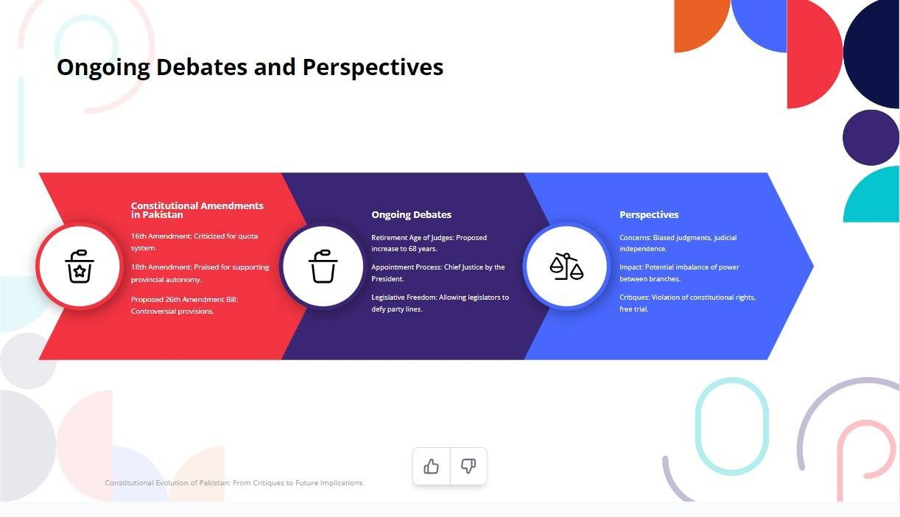
CamScanner

Slide 16
GROUP MEMBERS
AYESHA AFTAB ROLL#010
RAAZIA IMRAN ROLL#009
SULTAN AHMED ROLL#036

